Slide 1

How to implement a Fluid Simulation on the CPU with Unity

Slide 2
https://www.ypppt.com/
CONTENT
Introduction
PART 1
PART 2
Overview of SPH and Unity
PART 3
Key Features of SPH Implementation
PART 4
Further Work
PART 5
Conclusion

Slide 3
01
Introduction

Slide 4
01
The inception of SPH dates back to 1977, a seminal year when Gingold and Monaghan introduced this method to model oscillating or non-spherical stars.
Time
LIne
02
The turn of the millennium saw further advancements by Müller et al., who enhanced the realism of SPH simulations by deriving their methods from the Navier-Stokes fluid equations.
03
Most recently, the scope of SPH has broadened even further. Faber et al. used SPH to simulate interactions between stellar objects, including star mergers and astronomical collisions. Cao et al.

Slide 5
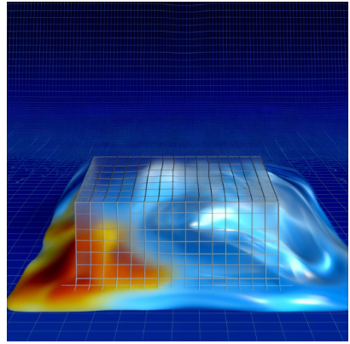
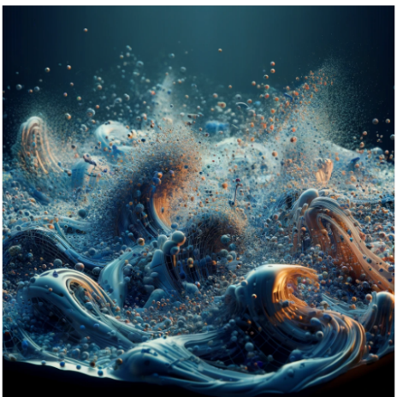
Eulerian Method
This method uses a stationary grid to simulate fluids by calculating properties like velocity and pressure at fixed points. It is effective for simulating gases, water, and diffusion, but less so for viscous fluids or tracking fluid interfaces, such as lava or honey.
Lagrangian Method
This approach models fluid using discrete particles that move and carry individual properties. It excels at simulating complex interactions like splashing and is ideal for non-Newtonian fluids and particulate flows. While it conserves mass and handles free surface flows well, it struggles with enforcing incompressibility.

Slide 6
02
Overview of SPH and Unity

Slide 7
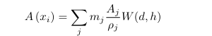

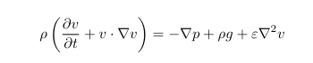
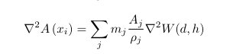
02
03
01
Navier-Stokes
04

Slide 8
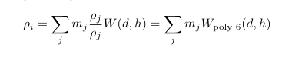
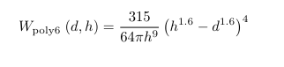
Density Calculation

Slide 9
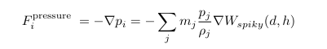
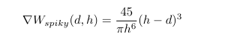
Pressure Forces

Slide 10
Our implementation further refines the calculation of pressure forces to ensure that forces remain symmetrical, preserving the momentum and energy within the system, a principle that is fundamental to all physics simulations.
Addressing Non-Uniformities

Slide 11
Viscosity is treated uniquely in our system by considering the relative velocities of particles. This approach allows the simulation to realistically model the laminar and turbulent flows of fluids. External forces like gravity and interactions with solid objects are seamlessly integrated using Unity's physics engine, enabling realistic and dynamic interactions within the simulation environment.
Viscosity and External Forces

Slide 12
To enhance performance and accuracy, we employ a spatial grid to manage particle interactions, reducing computational complexity from order n squared to order m times n, where n is the number of particles and m is a much smaller number representing nearby particles. This optimization is crucial for real-time applications where speed is as important as accuracy
Optimizations and Performance

Slide 13
03
Key Features of SPH Implementation

Slide 14
Unity's Innovative Approach
The SPH in Unity
Represents fluids using particles, each carrying properties like mass and velocity. The algorithm applies a smoothing kernel to manage interactions between particles within a specific radius, allowing for the calculation of properties such as density and pressure. Using the Navier-Stokes equations adapted for particles, SPH simulates dynamics like pressure gradients and viscosity. Unity's capabilities, including its physics engine and potential for GPU acceleration, enhance the efficiency and realism of these simulations.
In the summer of 2018, a transformative development occurred at Atomic Raccoon, an Indie Game Studio in Paris. The team, intrigued by the potential of Unity's newly introduced Entity Component System (ECS), Job System, and Burst compiler, decided to explore these tools through the lens of fluid simulation.

Slide 15
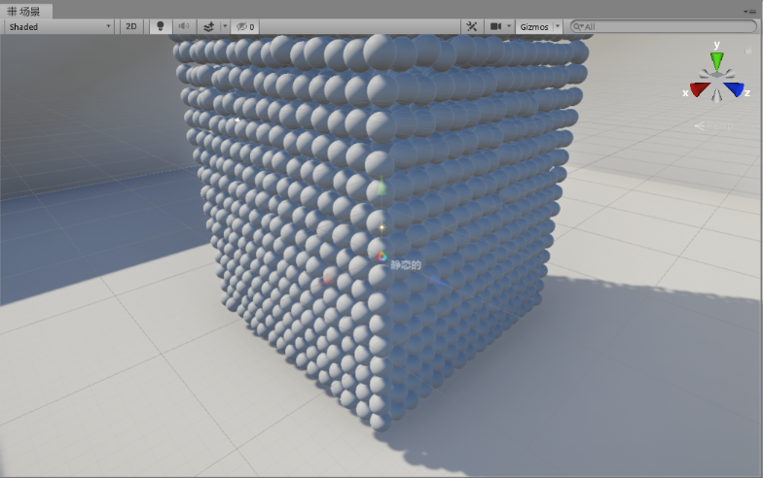
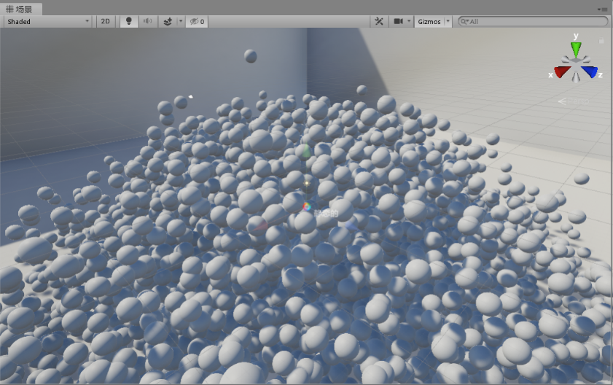
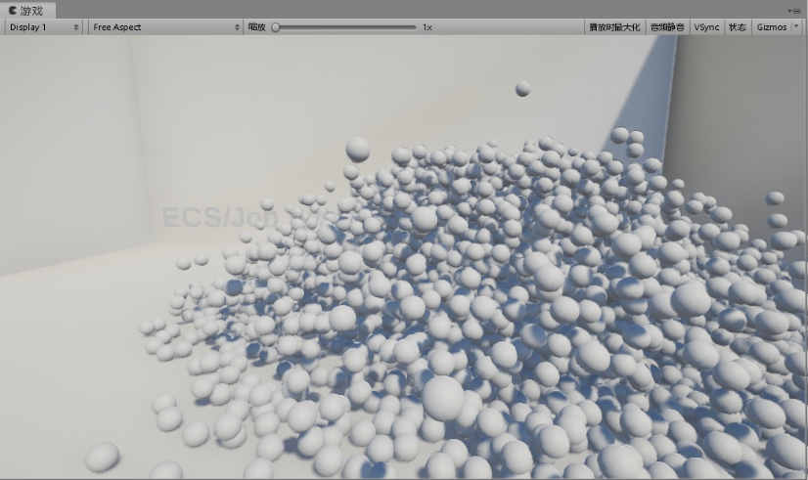
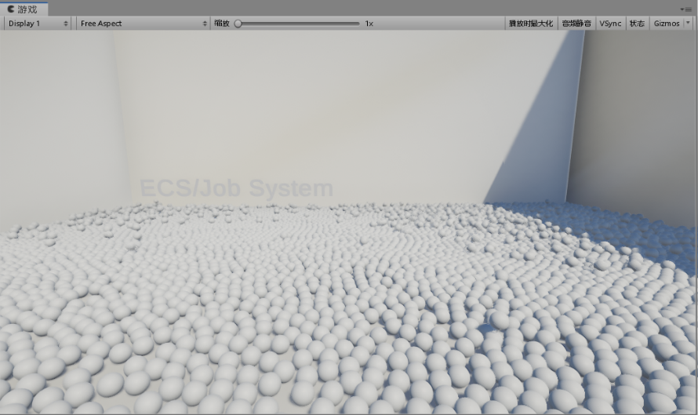
Notes:
https://www.ypppt.com/

Slide 16
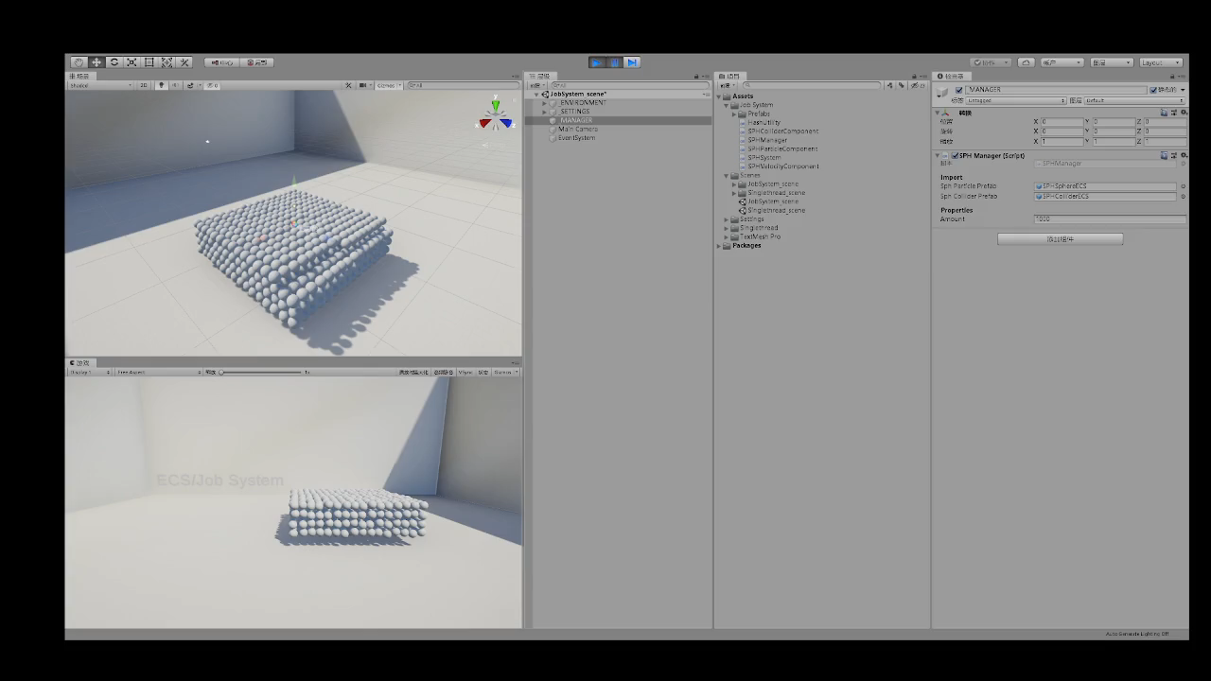
Notes:
https://www.ypppt.com/

Slide 17
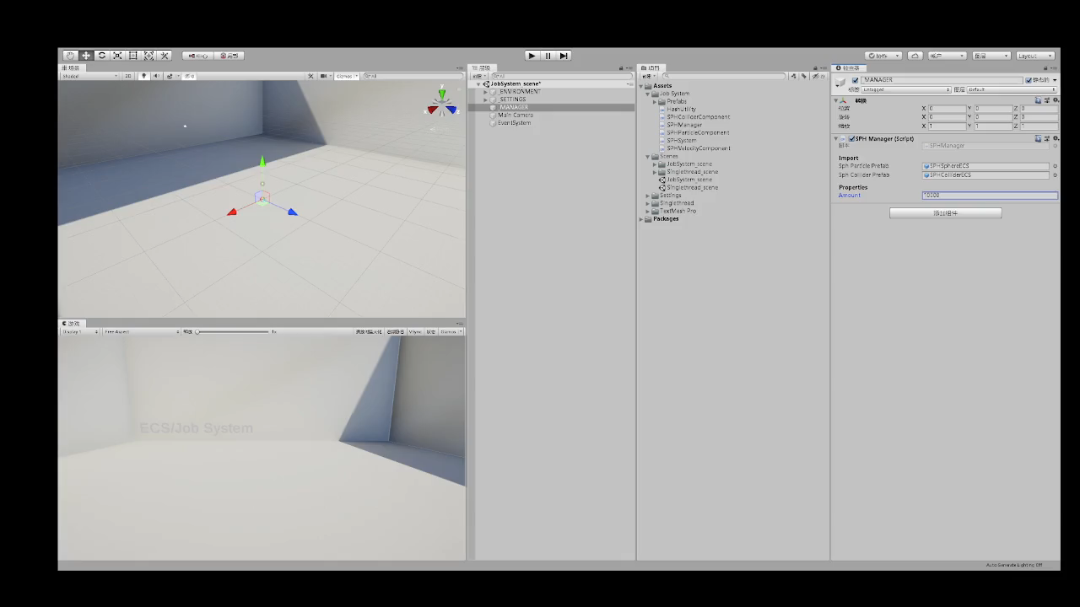
Notes:
https://www.ypppt.com/

Slide 18
04
Further Work

Slide 19
Future improvements may include implementing what Clavet et al.[CBP05] call the ”double density relaxation”. This process differentiates neighbour particles into the categories of neighbour and close neighbour. Force contributions are then measured differently depending on whether particles are regular or close neighbours. Surface tension forces can be added to further increase the stability and realism of particles at the surface of the fluid

Slide 20
05
Conclusion

Slide 21

This paper presented a SPH implemented within the Unity game engine. With Unity, the problems of rendering and collision detection were simplified through using its internal systems. Using the NavierStokes equation as a base and building upon it with smoothing kernels and a spatial grid, it is able to achieve running simulations of 5000 particles with the upper limit of to 10000 particles. Much can still be improved in regards to speed, stability, and visuals.

